Slide 1
CRYPTOGRAPHY
By:Gaurav Prasad

Slide 2
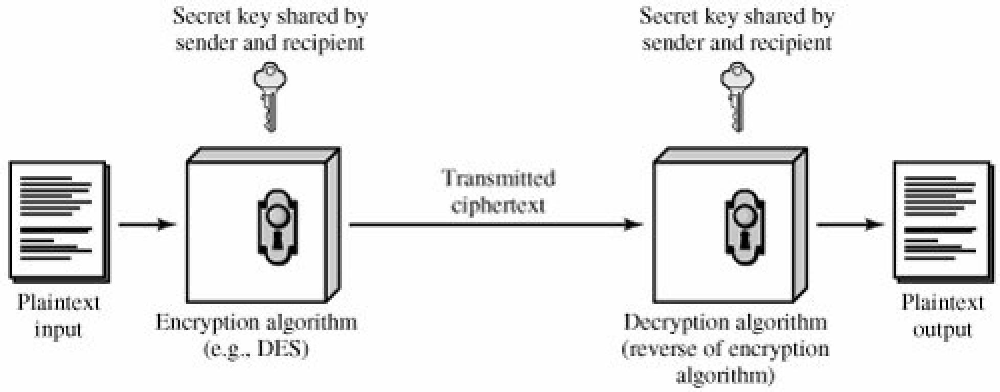

Slide 3
Cryptographic:Dimensions:
The type of operations used for transforming plaintext to ciphertext(substitution, in which each element in the plaintext (bit, letter, group of bits or letters) is mapped into another element, and transposition, in which elements in the plaintext are rearranged).
The number of keys used. If both sender and receiver use the same key, the system is referred to as symmetric, single-key,secret-key, or conventional encryption. If the sender and receiver use different keys, the system is referred to as asymmetric, two-key, or public-key encryption.
The way in which the plaintext is processed. A block cipher processes the input one block of elements at a time, producing an output block for each input block. A stream cipher processes the input elements continuously, producing output one element at a time, as it goes along.

Slide 4
approaches to attacking a conventional encryption scheme
Cryptanalysis: Cryptanalytic attacks rely on the nature of the algorithm plus perhaps some knowledge of the general characteristics of the plaintext or even some sample plaintext-cipher text pairs.
Brute-force attack: The attacker tries every possible key on a piece of cipher text until an intelligible translation into plaintext is obtained. On average, half of all possible keys must be tried to achieve success.

Slide 5
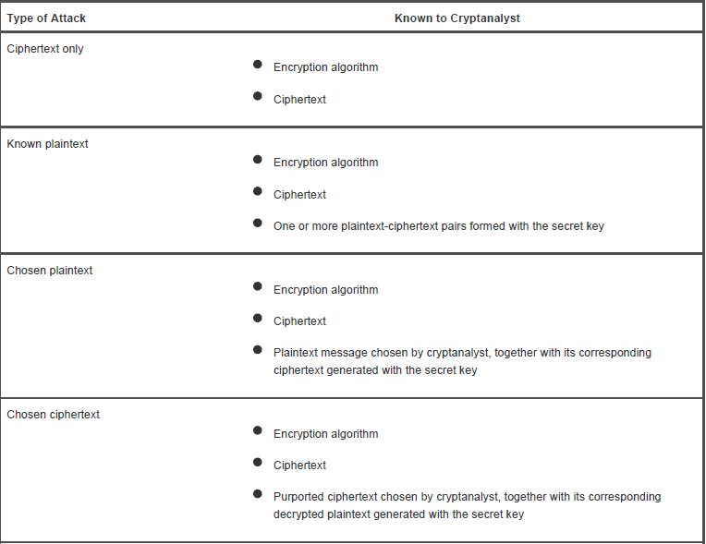
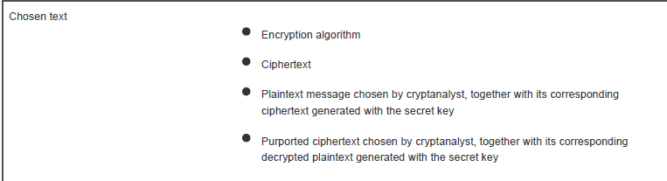

Slide 6
Caesar Cipher
The earliest known use of a substitution cipher, and the simplest, was by Julius Caesar. The Caesar cipher involves replacing each letter of the alphabet with the letter standing three places further down the alphabet. For example k=3
plain: meet me after the toga party
cipher: PHHW PH DIWHU WKH WRJD SDUWB
so that the general Caesar algorithm is
C = E(k, p) = (p + k) mod 26
where k takes on a value in the range 1 to 25. The decryption algorithm is simply
p = D(k, C) = (C k) mod 26

Slide 7
Playfair Cipher
The matrix is constructed by filling in the letters of the keyword (minus duplicates) from left to right and from top to bottom, and then filling in the remainder of the matrix with the remaining letters in alphabetic order.
The letters I and J count as one letter. Plaintext is encrypted two letters at a time, according to the following rules:
1. Repeating plaintext letters that are in the same pair are separated with a filler letter, such as x, so that balloon would be treated as ba lx lo on.
2. Two plaintext letters that fall in the same row of the matrix are each replaced by the letter to the right, with the first element of the row circularly following the last. For example, ar is encrypted as RM.
3. Two plaintext letters that fall in the same column are each replaced by the letter beneath, with the top element of the column circularly following the last. For example, mu is encrypted as CM.
4. Otherwise, each plaintext letter in a pair is replaced by the letter that lies in its own row and the column occupied by the other
plaintext letter. Thus, hs becomes BP and ea becomes IM (or JM, as the encipherer wishes).
The Matrix is shown in the next page
Note: In this case, the keyword is monarchy

Slide 8
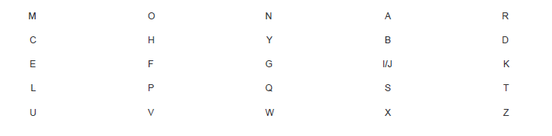

Slide 9

Hill Cipher
This can be expressed in term of column vectors and matrices:
C = KP mod 26
where C and P are column vectors of length 3, representing the plaintext and ciphertext, and K is a 3 x 3 matrix, representing the encryption key. Operations are performed mod 26.

Slide 10
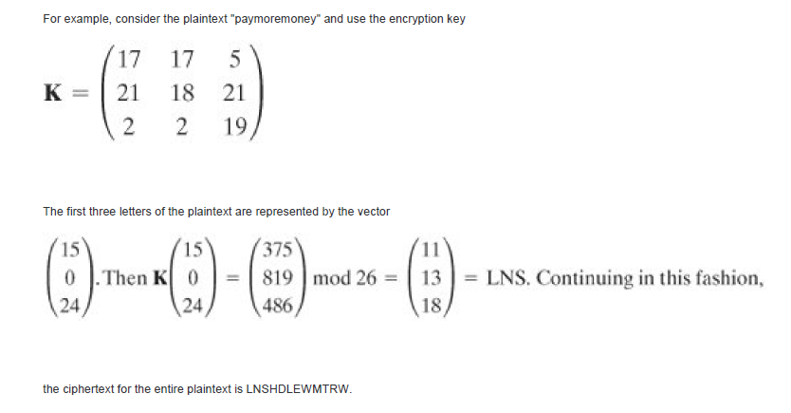

Slide 11
Transposition Techniques
The simplest such cipher is the rail fence technique, in which the plaintext is written down as a sequence of diagonals and then read off as a sequence of rows. For example, to encipher the message "meet me after the toga party" with a rail fence of depth 2, we write the following:
m e m a t r h t g p r y
e t e f e t e o a a t
The encrypted message is
MEMATRHTGPRYETEFETEOAAT

Slide 12
Steganography
Steganography(from Greek Stegános, "Covered/hidden", and gráphein, "to write") is the art and science of communicating in a way which hides the existence of the communication
Steganography hides the very existence of the message by embedding it inside a carrier file of some type. An avesdropper can intercept a cryptographic message, but he may not even know that a steganographic message exists.
Cryptography and Steganography achieve the same goal via different means. Encryption encodes the data so that an unintended recipient cannot determine its intended meaning. Steganography, in contrast attempts to prevent an unintended recipient from suspecting that the data is there.

Slide 13
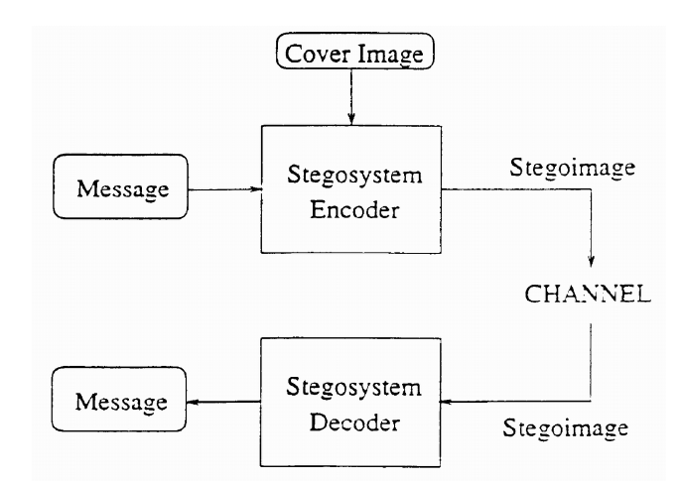

Slide 14
LSB Method

Slide 15
S-DES
S-DES is a reduced version of the DES algorithm. It has similar properties to DES but deals with a much smaller block and key size (operates on 8-bit message blocks with a 10-bit key).
Block cipher
Single/Symmetric key

Slide 16
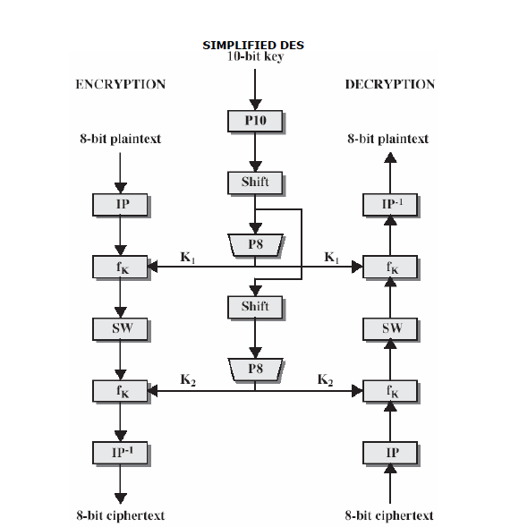

Slide 17
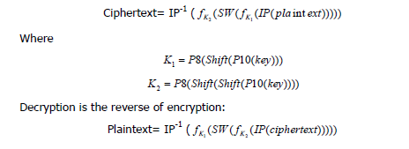
Encryption algorithm

Slide 18
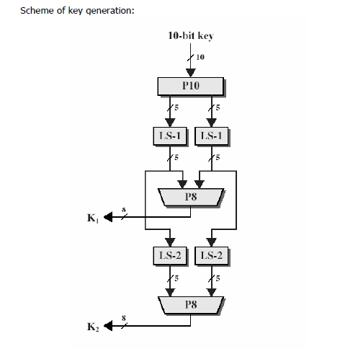
S-DES KEY GENERATION

Slide 19

P10

Slide 20

P8

Slide 21
Example
For example, the key (1010000010)
Step 1:apply p10 permuted to get (1000001100).
Next, perform a circular shift (LS-1), or rotation, separately on the 1st 5 bits and the 2nd 5 bits. In our example, the result is (00001 11000)
Next, we apply P8 , In our example, this yields (10100100)
We then go back to the pair of 5-bit strings produced by the 2 LS-1 functions and perform a circular left shift of 2 bit positions on each string.
In our example, the value (00001 11000) becomes (00100 00011). Finally, P8 is applied again to produce K2. In our example, the result is (01000011)

Slide 22
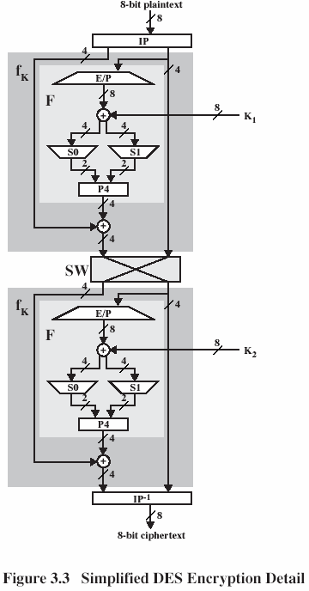
SDES

Slide 23






Slide 24
S BOX
The S-boxes operate as follows. The 1st and 4th input bits are treated as a 2-bit number that specify a row of the S-box, and the 2nd and 3rd input bits specify a column of the S-box.
For example, if input S box is 0100 then
(p00, p03) = (00) and (p01, p02) = (10),
then the output is from row 0, column 2 of S0, which is 3, or (11) in binary.

Slide 25
DES
The most widely used encryption scheme is based on the Data Encryption Standard (DES) adopted in 1977 by the National Bureau of Standards, now the National Institute of Standards and Technology (NIST), as Federal Information Processing Standard 46
The algorithm itself is referred to as the Data Encryption Algorithm (DEA).For DES, data are encrypted in 64-bit blocks using a 56-bit key. The algorithm transforms 64-bit input in a series of steps into a 64-bit output. The same steps, with the same key, are used to reverse the encryption

Slide 26
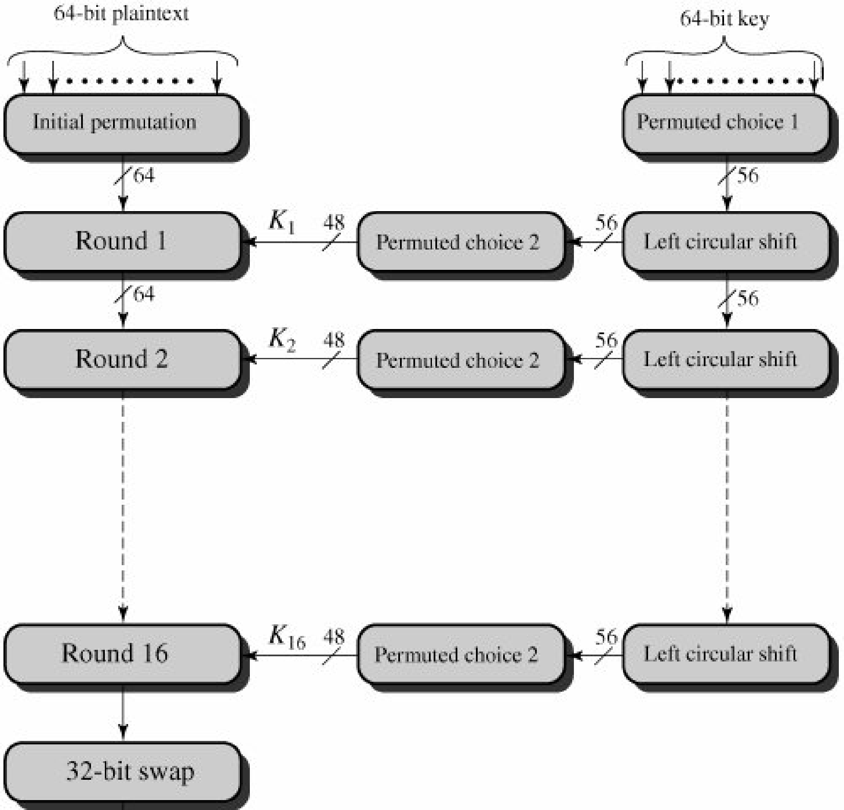
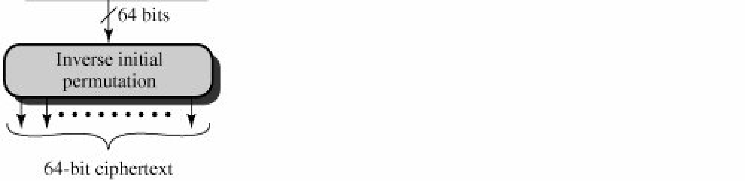
DES

Slide 27
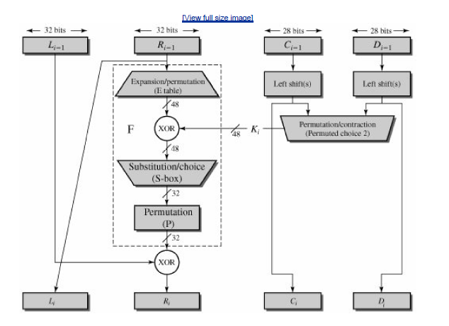

Slide 28
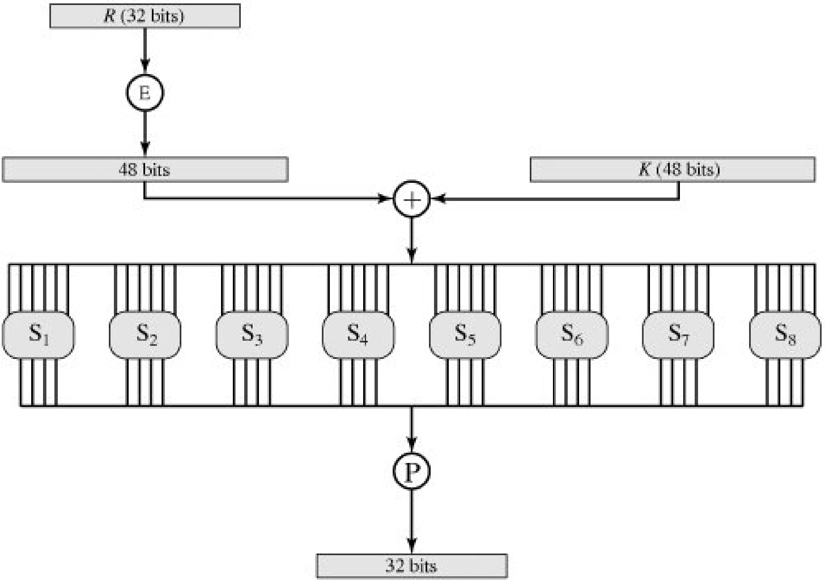

Slide 29
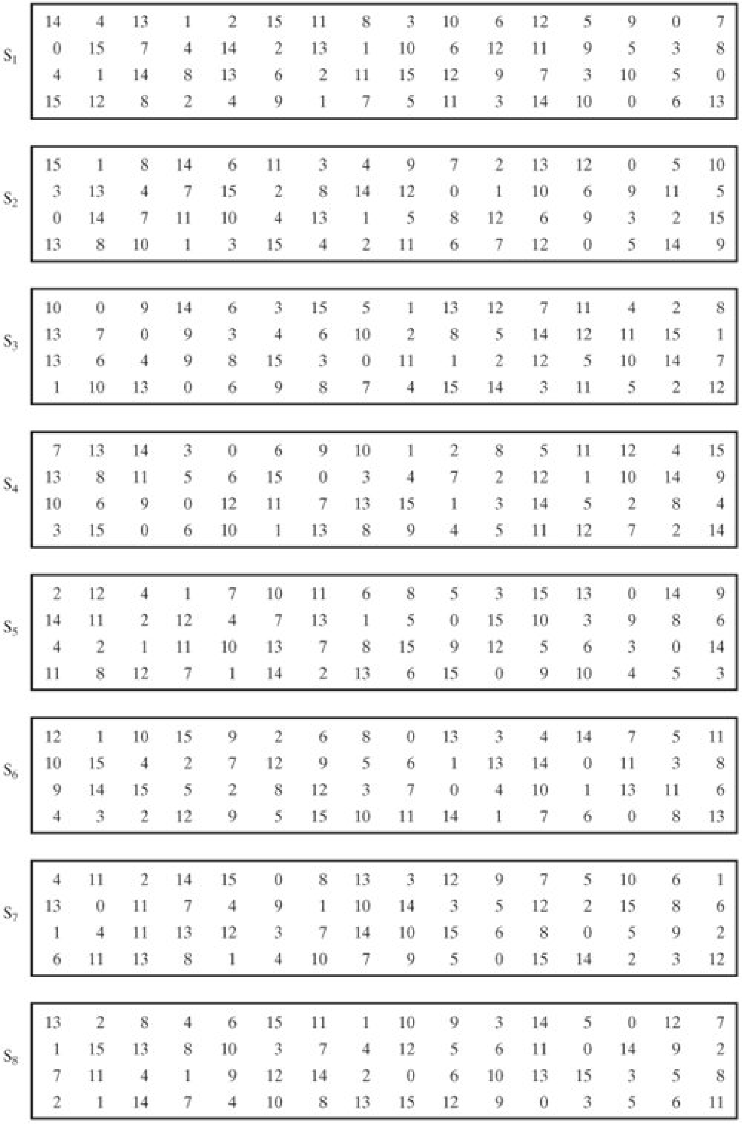

Slide 30
Public-Key Encryption
8.1 Prime Numbers
8.2 Fermat's and Euler's Theorems
Fermat's Theorem
Euler's Totient Function
Euler's Theorem
8.3 Testing for Primality
Miller-Rabin Algorithm
A Deterministic Primality Algorithm
Distribution of Primes
8.4 The Chinese Remainder Theorem
8.5 Discrete Logarithms
The Powers of an Integer, Modulo n
Logarithms for Modular Arithmetic
Calculation of Discrete Logarithms

Slide 31
A public-key encryption scheme has six ingredients
Plaintext: This is the readable message or data that is fed into the algorithm as input.
Encryption algorithm: The encryption algorithm performs various transformations on the plaintext.
Public and private keys: This is a pair of keys that have been selected so that if one is used for encryption, the other is used for decryption. The exact transformations performed by the algorithm depend on the public or private key that is provided as input.
Ciphertext: This is the scrambled message produced as output. It depends on the plaintext and the key. For a given message, two different keys will produce two different ciphertexts.
Decryption algorithm: This algorithm accepts the ciphertext and the matching key and produces the original plaintext.

Slide 32
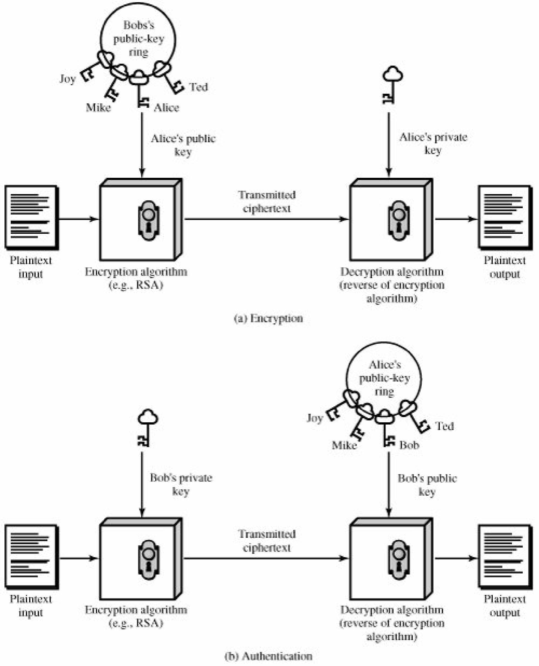

Slide 33
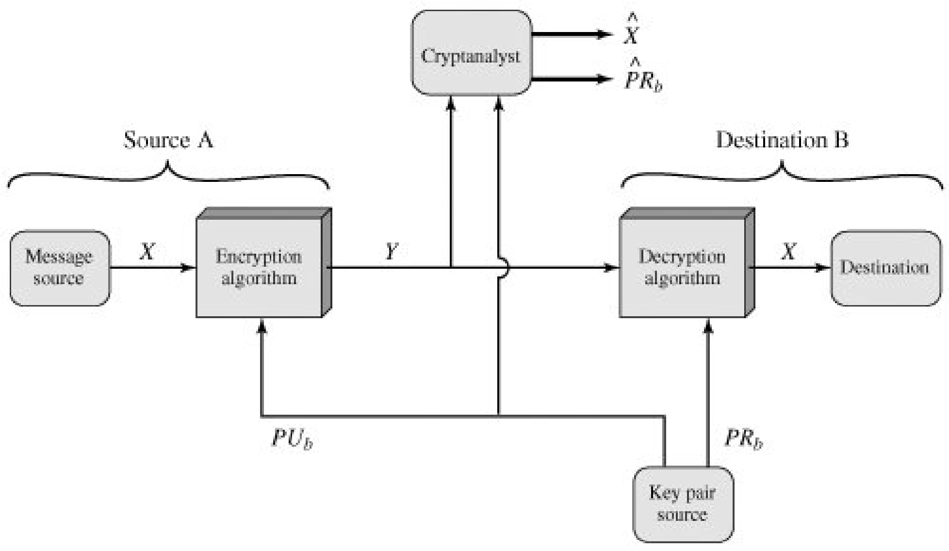

Slide 34
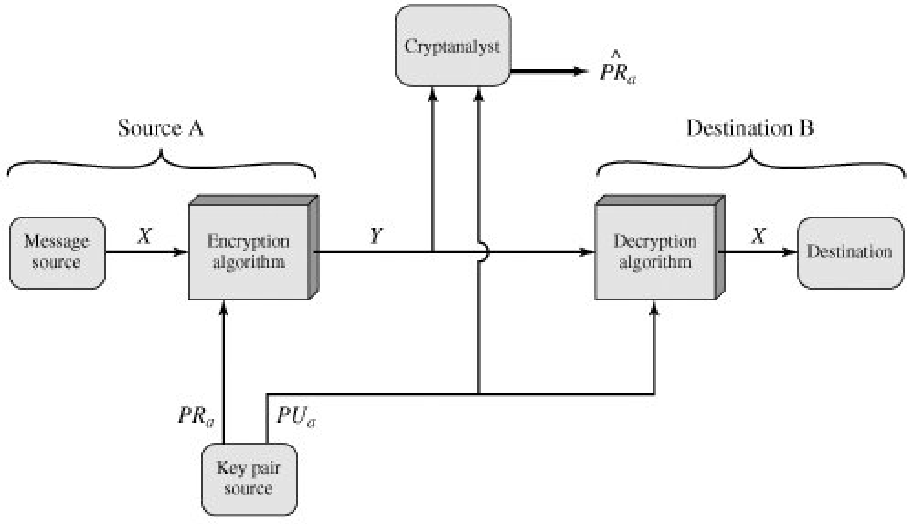

Slide 35
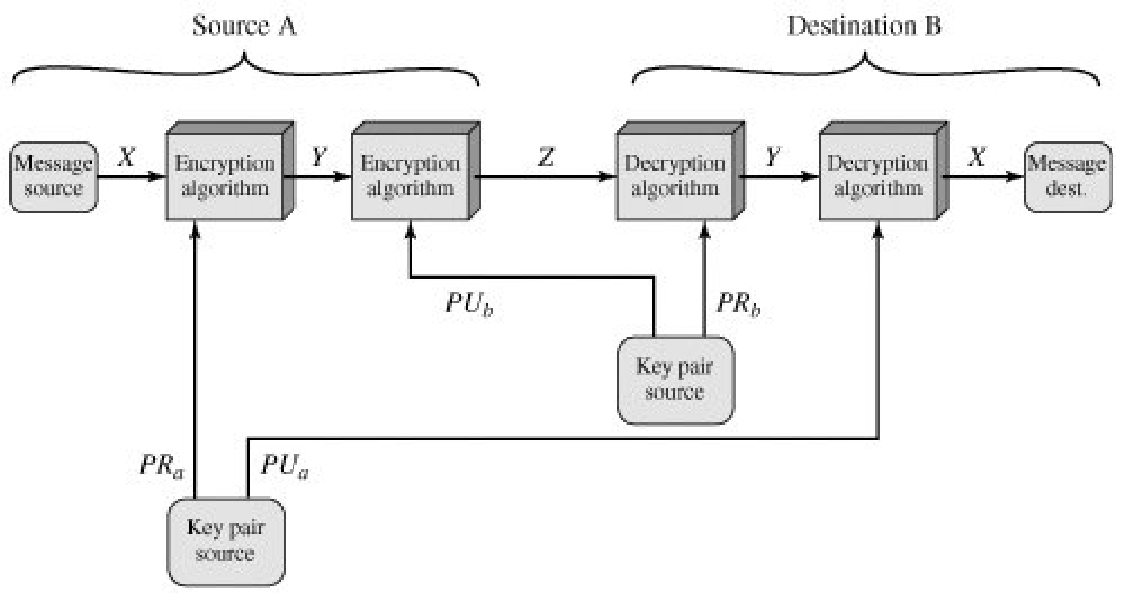

Slide 36
Authentication
BY DEFAULT

Slide 37
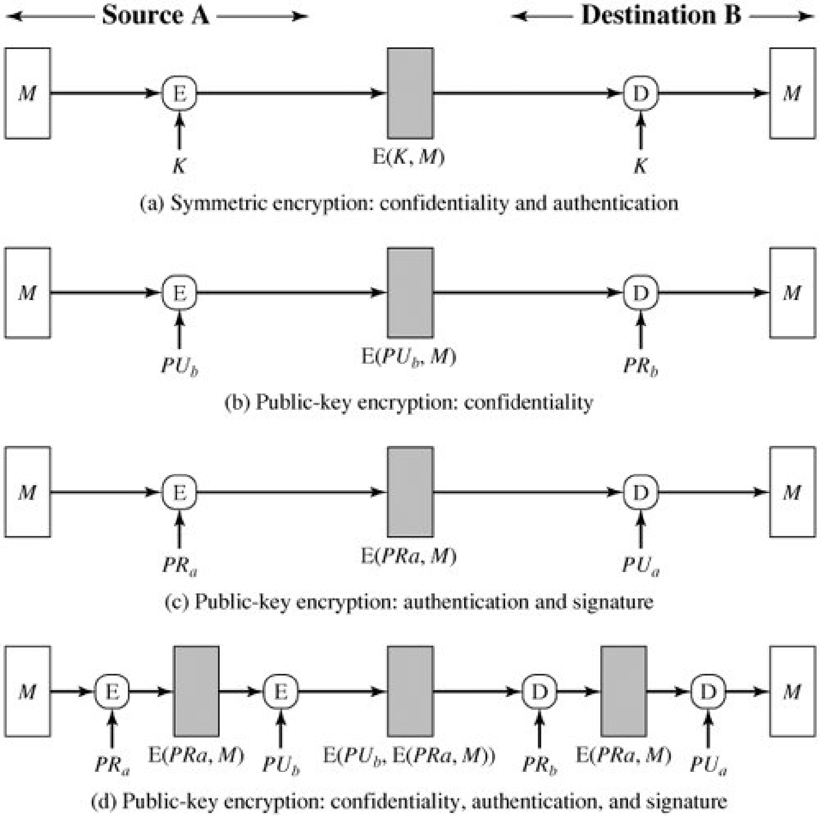

Slide 38
Message Authentication Code
An alternative authentication technique involves the use of a secret key to generate a small fixed-size block of data, known as a cryptographic checksum or MAC that is appended to the message.
This technique assumes that two communicating parties, say A and B,
share a common secret key K.
When A has a message to send to B, it calculates the MAC as a function of the message and the key:MAC
= C(K, M), where M = input message C = MAC function
K = shared secret key MAC = message authentication code

Slide 39
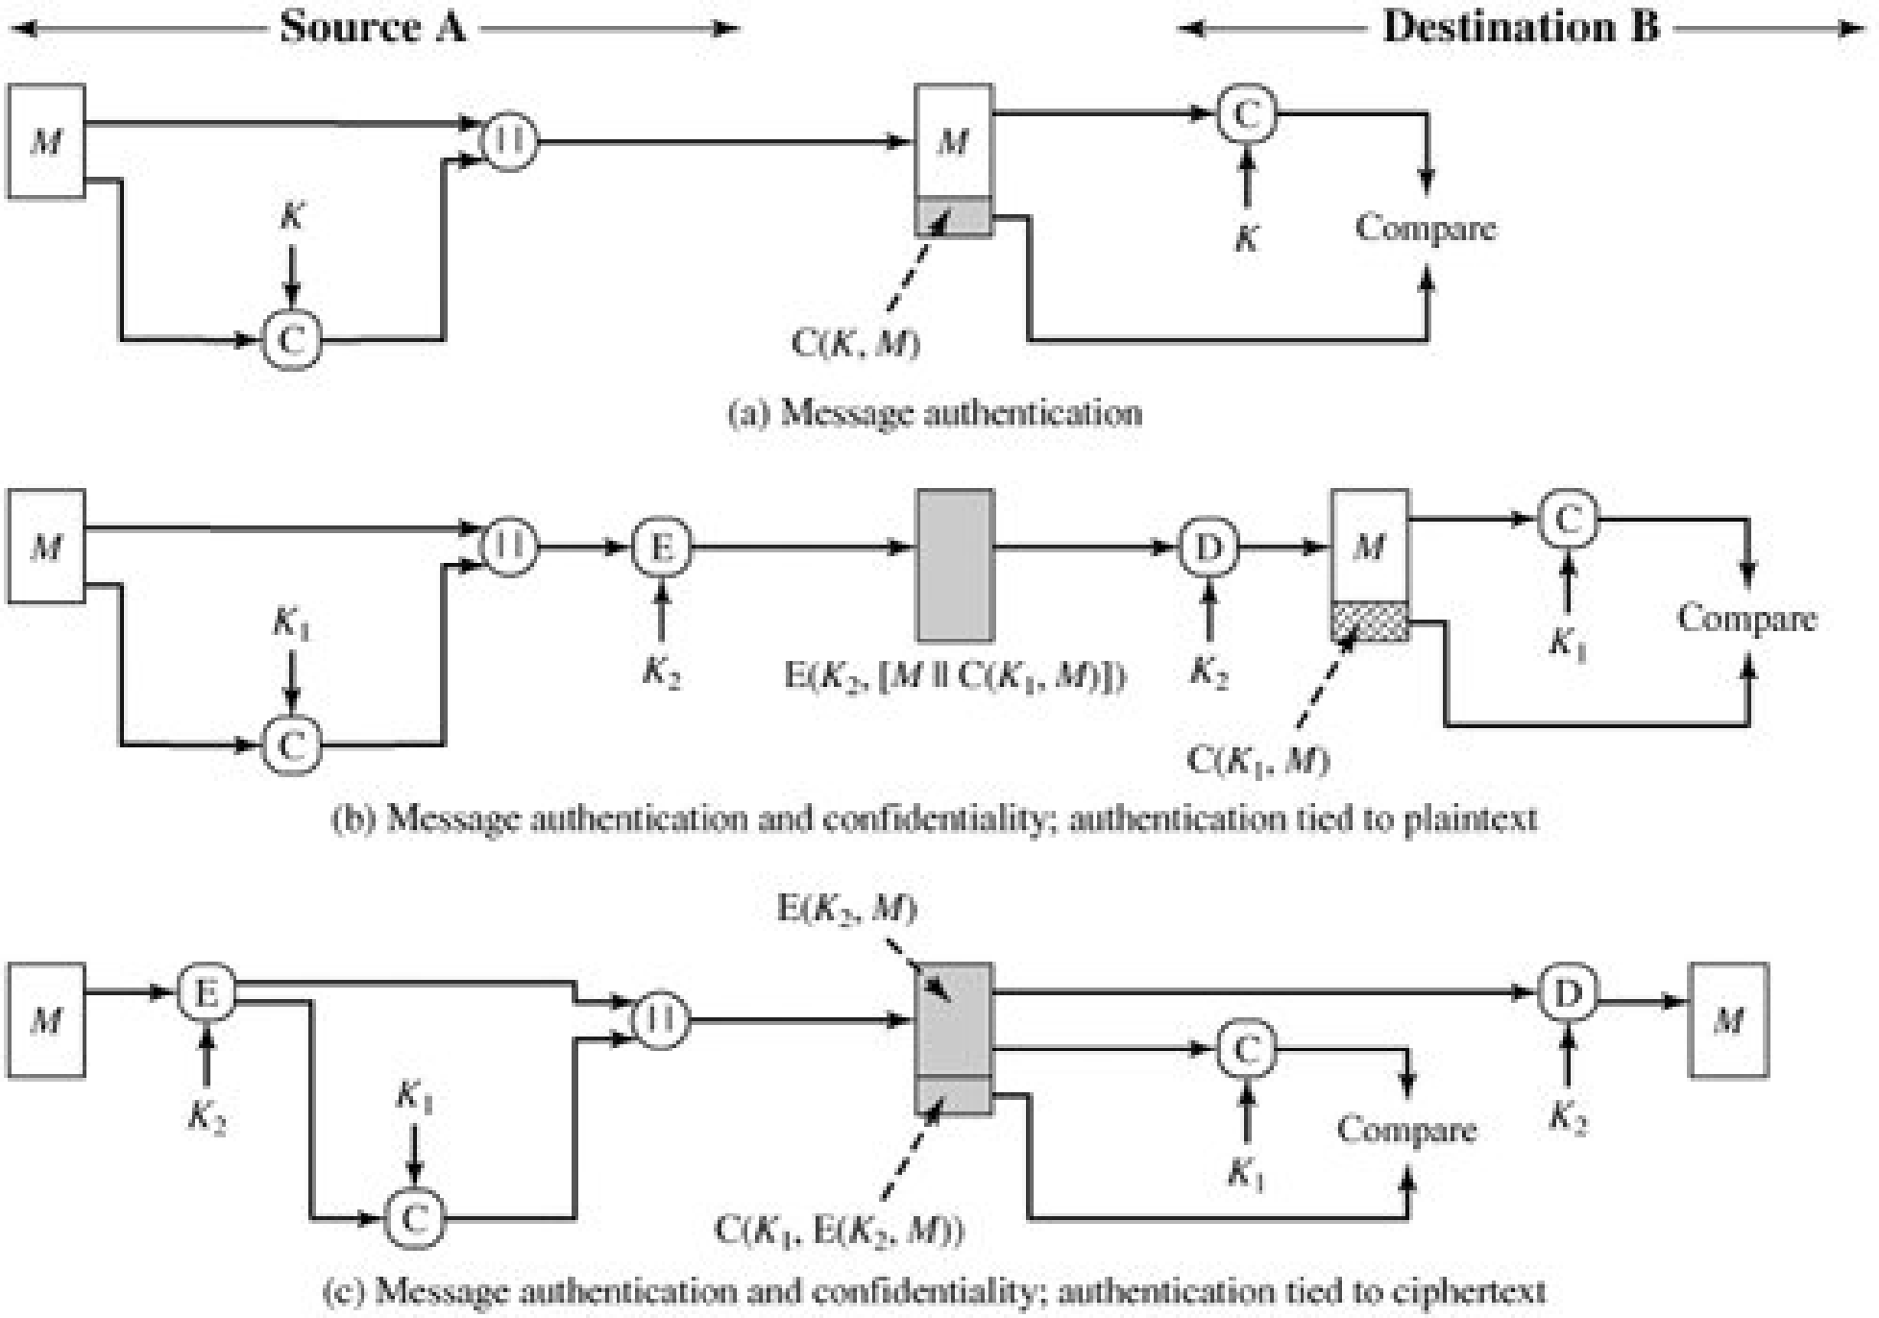

Slide 40
Hash Function
A variation on the message authentication code is the one-way hash function. As with the message authentication code, a hash function accepts a variable-size message M as input and produces a fixed-size output, referred to as a hash code H(M).
Unlike a MAC, a hash code does not use a key but is a function only of the input message. The hash code is also referred to as a message digest or hash value.
The hash code is a function of all the bits of the message and provides an error-detection capability: A change to any bit or bits in the message results in a change to the hash code

Slide 41
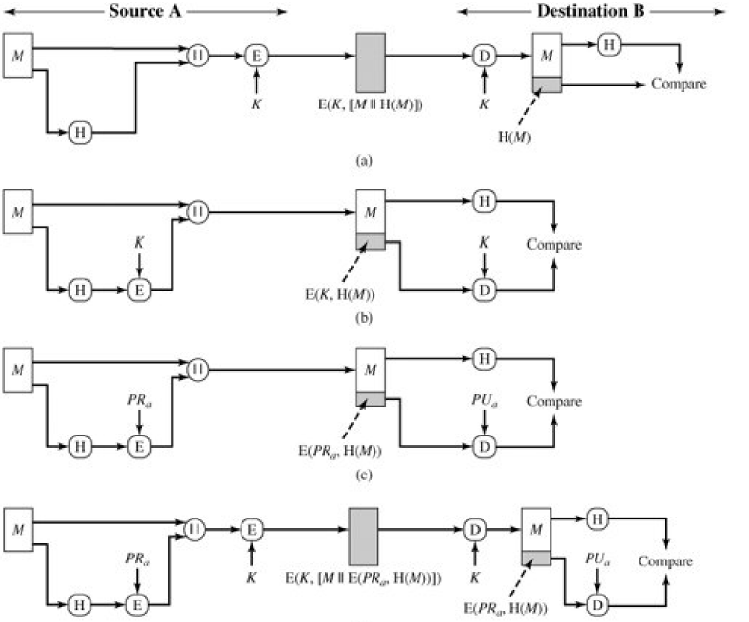

Slide 42
Key Management
The distribution of public keys
The use of public-key encryption to distribute secret keys

Slide 43
Distribution of Public Keys
Public announcement
Publicly available directory
Public-key authority
Public-key certificates

Slide 44
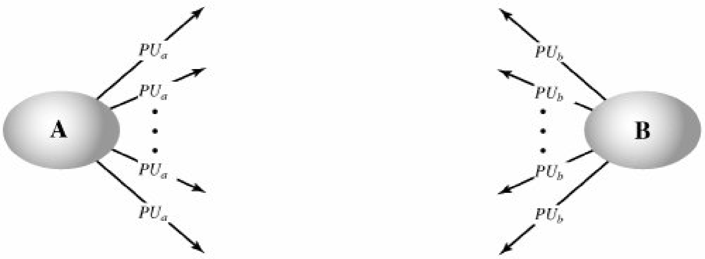
Public Announcement of Public Keys

Slide 45
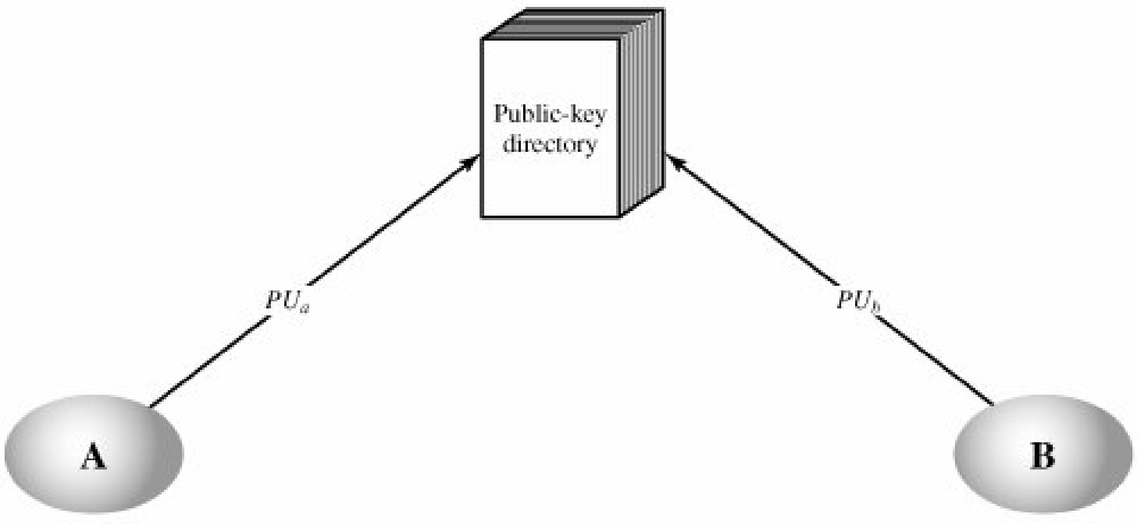
Publicly Available Directory

Slide 46
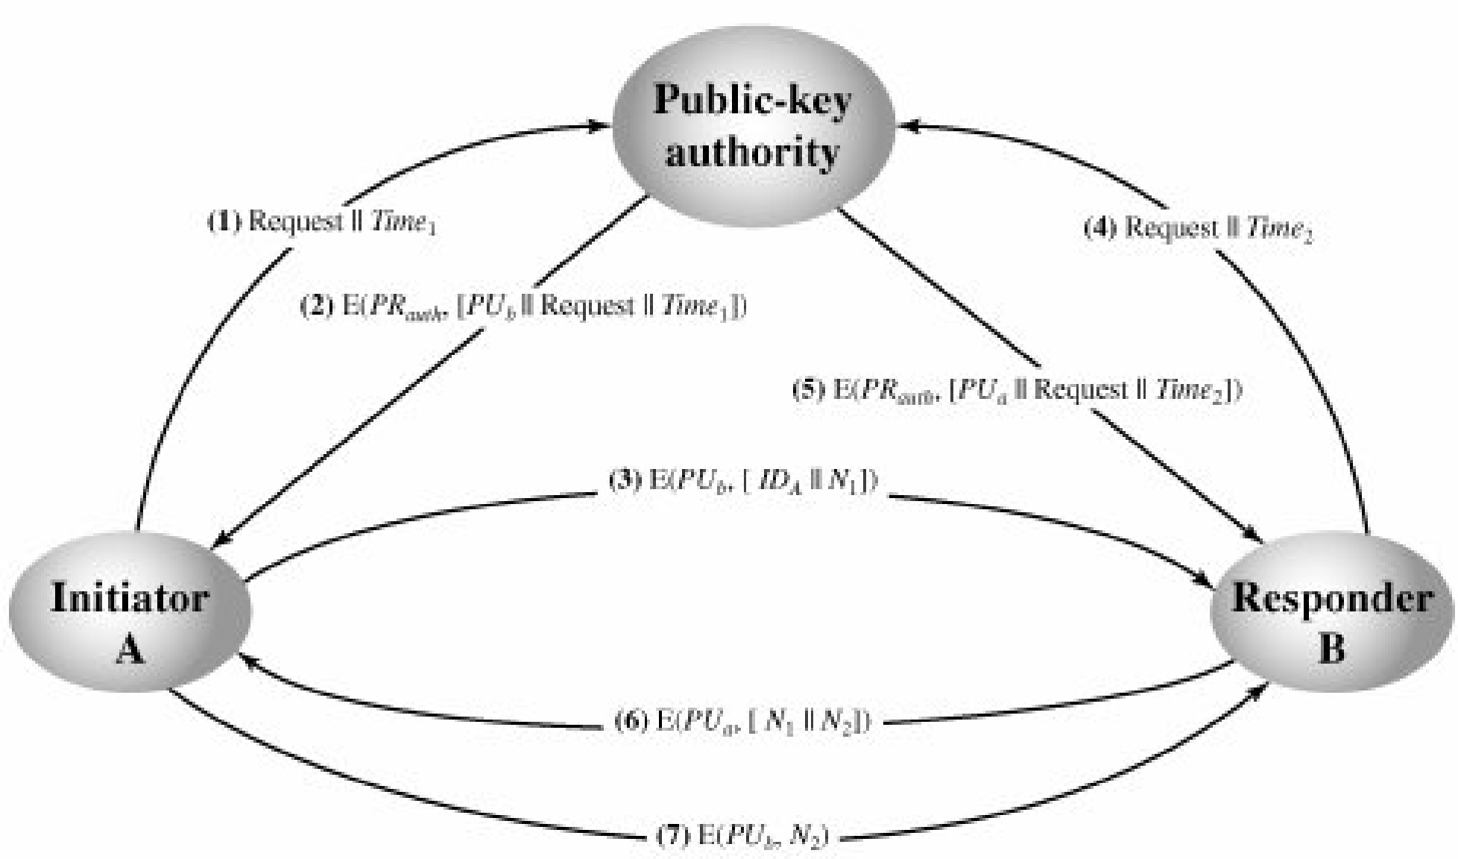
Public-Key Authority

Slide 47
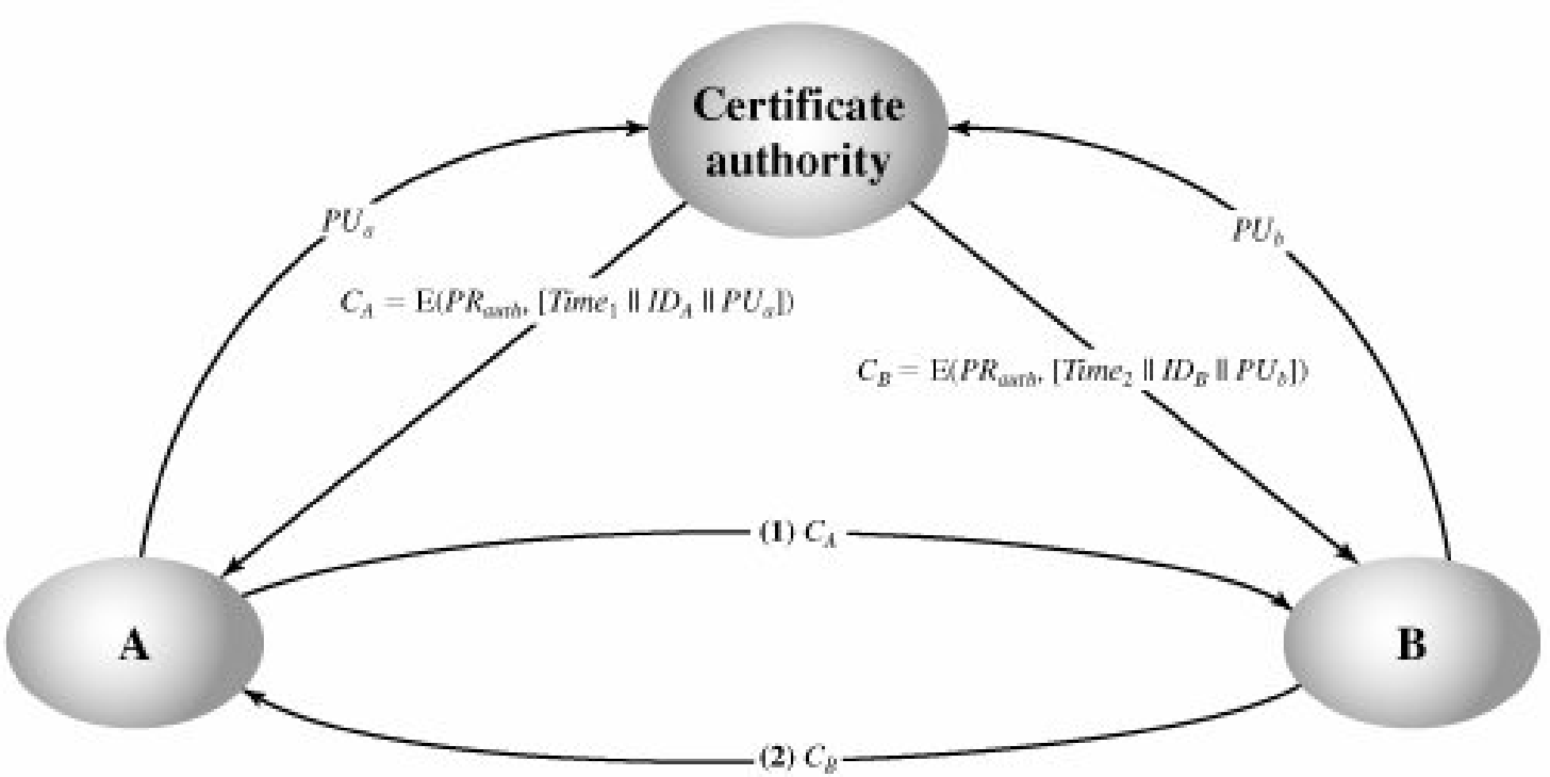
Public-Key Certificates

Slide 48
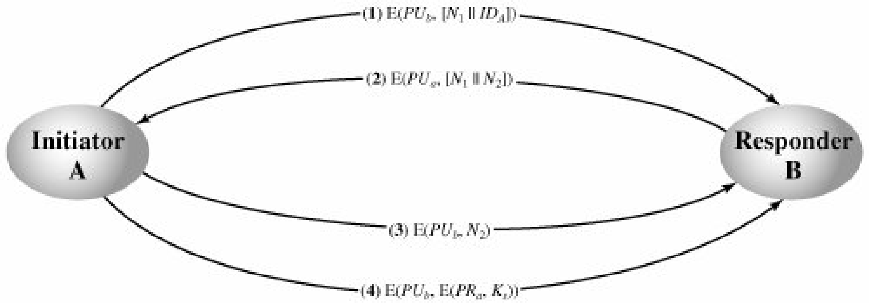
Public-Key Distribution of Secret Keys

Slide 49
LEFT OUT
RSA
Diffie-Hellman Key Exchange

Slide 50
Diffie-Hellman Key Exchange
The purpose of the algorithm is to enable two users to securely exchange a key that can then be used for subsequent encryption of messages.
The algorithm itself is limited to the exchange of secret values

Slide 51
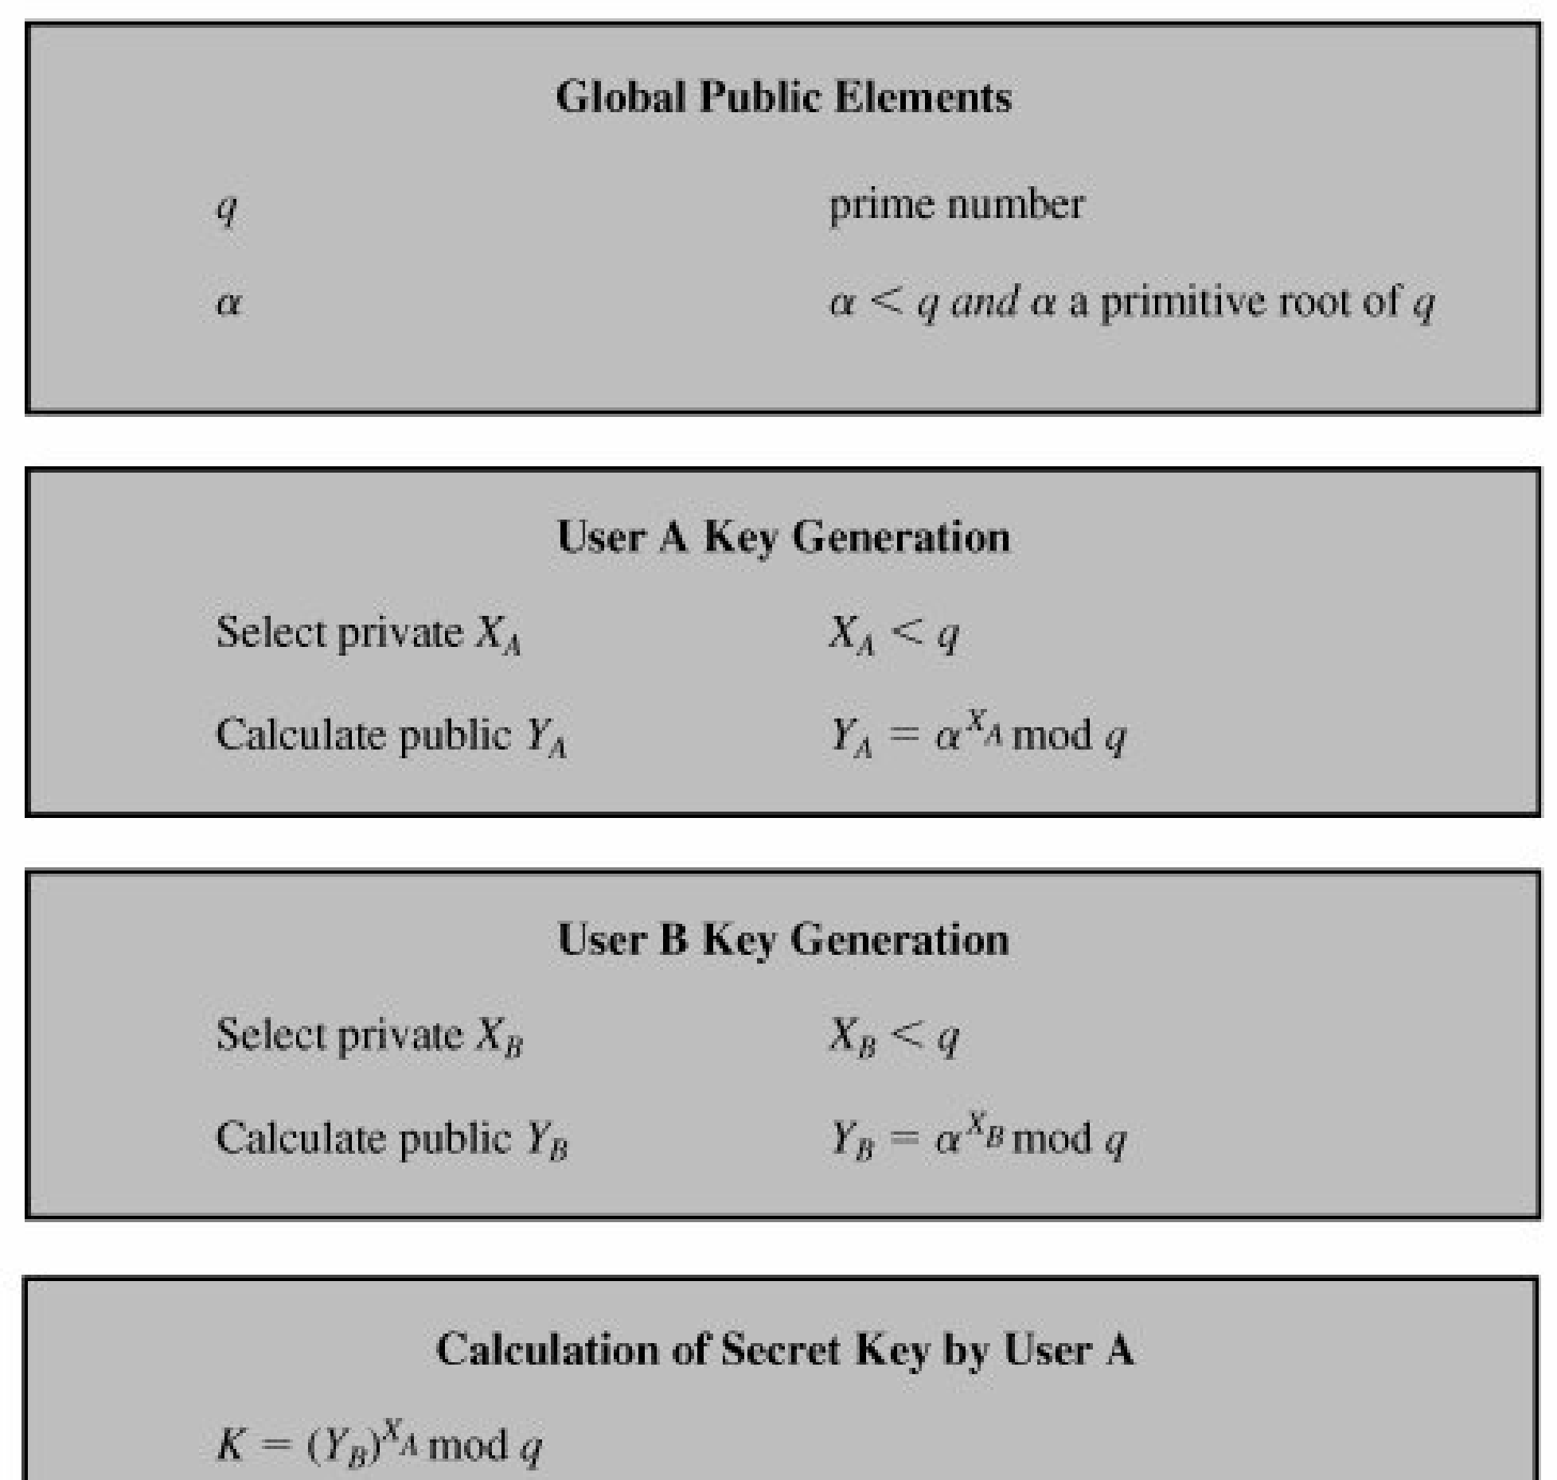
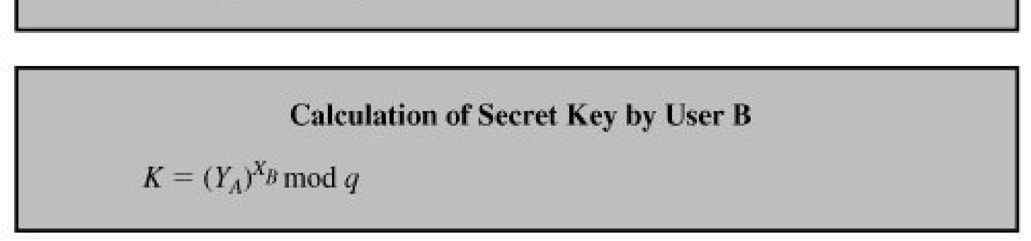

Slide 52
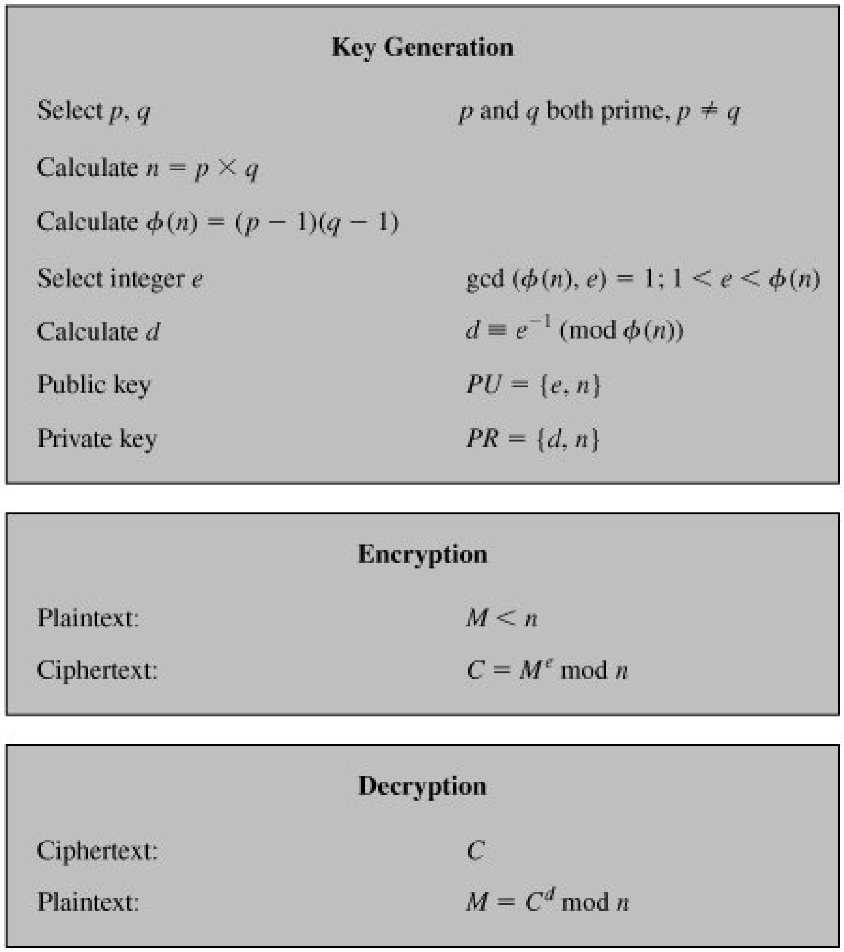
RSA

Slide 53
Example
Example of RSA with small numbers:
p = 47, q = 71, compute n = pq = 3337
Compute phi = 46 * 70 = 3220
Let e be 79, compute d = 79-1 mod 3220 = 1019
Public key is n and e, private key d, discard p and q.
Encrypt message m = 688, 68879 mod 3337 = 1570 = c.
Decrypt message c = 1570, 15701019 mod 3337 = 688 = m.

Slide 54
Example
1. Select two prime numbers, p = 17 and q = 11.
2. Calculate n = pq = 17 x 11 = 187.
3. Calculate phi(n) = (p 1)(q 1) = 16 x 10 = 160.
4. Select e such that e is relatively prime to phi(n) = 160 and less than phi(n) we choose e = 7.
Determine d such that de 1 (mod 160) and d < 160. The correct value is d = 23, because 23 x 7 = 161 = 10 x 160 + 1; d can be calculated using the extended Euclid's algorithm

Slide 55
The resulting keys are public key PU = {7,187} and private key PR = {23,187}. The example shows the use of these keys for a plaintext
input of M = 88. For encryption, we need to calculate C = 88 power 7 mod 187. Exploiting the properties of modular arithmetic, we can do this as follows:
88 power 7 mod 187 = [(88 pow 4 mod 187) x (88 pow 2 mod 187) x (88 pow 1 mod 187)] mod 187
88 pow 7 mod 187 = (88 x 77 x 132) mod 187 = 894,432 mod 187 = 11
For decryption, we calculate M = 11 pow 23 mod 187
11 pow 23 mod 187 = (11 x 121 x 55 x 33 x 33) mod 187 = 79,720,245 mod 187 = 88

Slide 56
Example for RSA Algorithm
Let p = 17 and q = 23
The value of n = p*q = 17*23 = 391
(p-1)*(q-1) = 16*22 = 352
Choose the encryption key e = 13, which is relatively prime to 352 =(p-1)*(q-1).
The decryption key d is the multiplicative inverse of 13 modulo 352.
We find the decryption key d to be 325
The encryption key is (13, 391)
The decryption key is (325, 391)

Slide 57
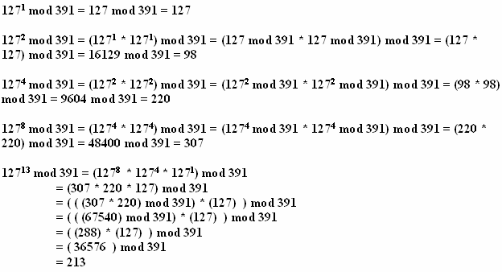
Cont..
Encryption for Plaintext P = 127
Ciphertext C = P power e mod n= 12713 mod 391

Slide 58
Answer
Cipher text is 213

Slide 59
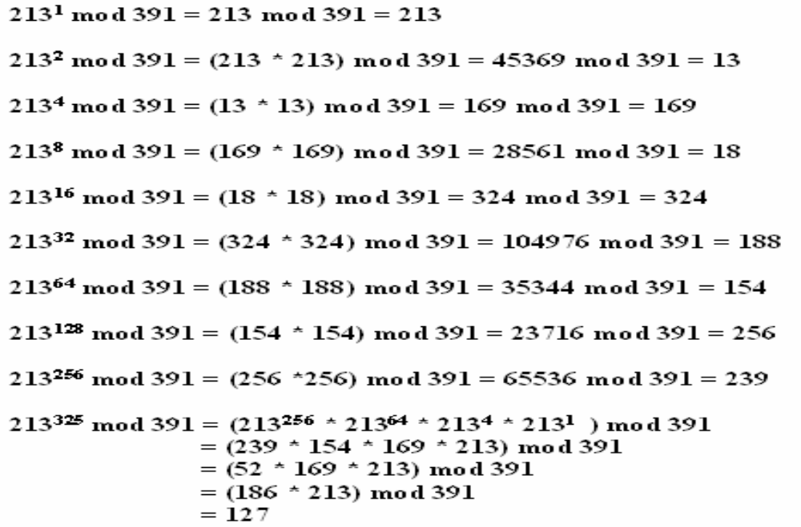

Slide 60
END OF CRYPTOGRAPHY

